Slide 1


Google Play Store app ratings
Assaf Berman
Ben Pinhasov

Slide 2

Goal
Predict app’s rating by apps market properties and user reviews
Method
Explore data and find relations between features and label
Build regression models for prediction:
Simple linear regression
Regression Random Forest
XGBoost
Optimize hyper-parameters of selected model for best prediction results

Slide 3
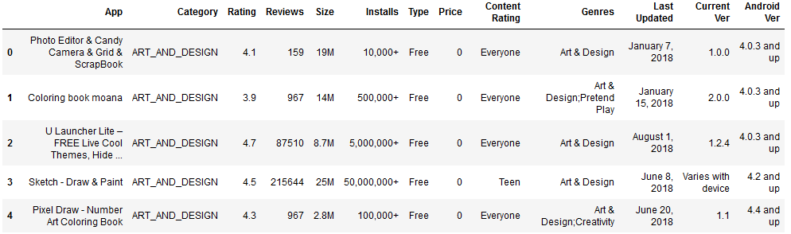
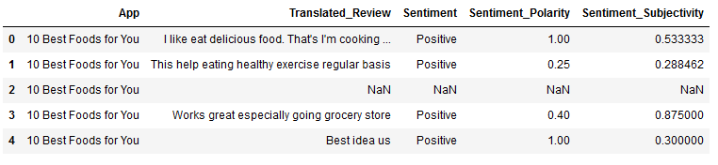
Data Exploration
df_apps
df_reviews
Data cleaning
Size converted to bytes (numeric)
Installs converted to number
Type was label encoded
Sentiment was ordinally encoded

Slide 4
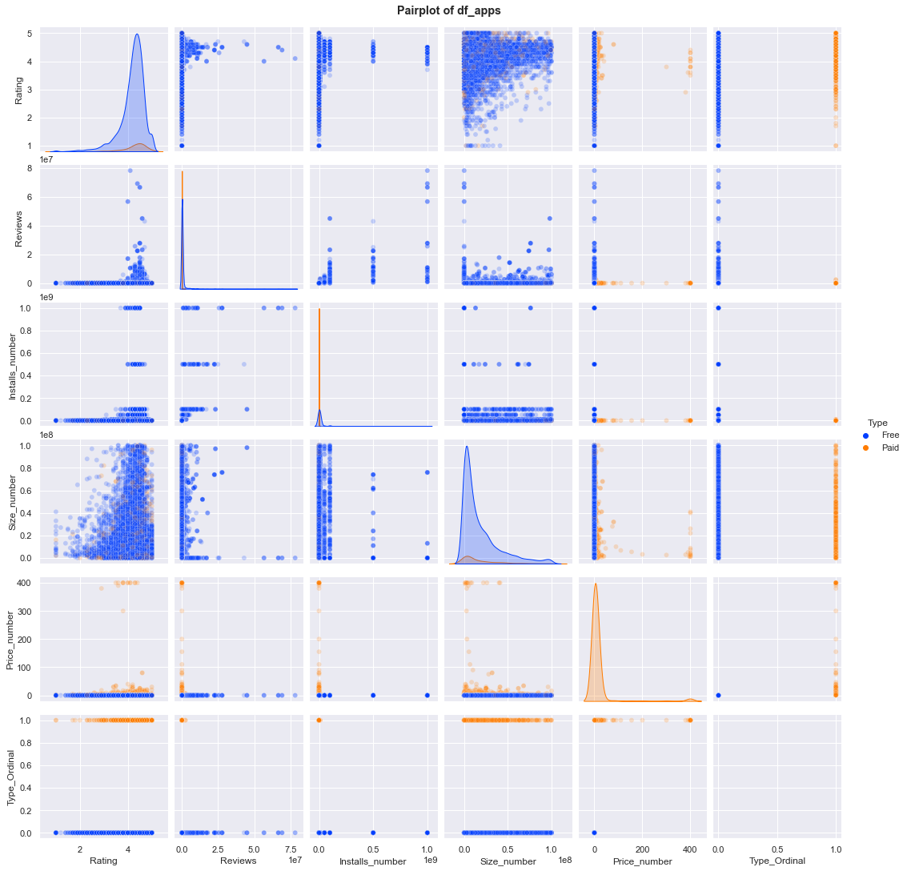
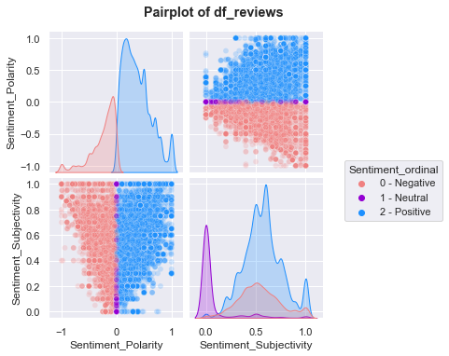
Data Exploration

Slide 5
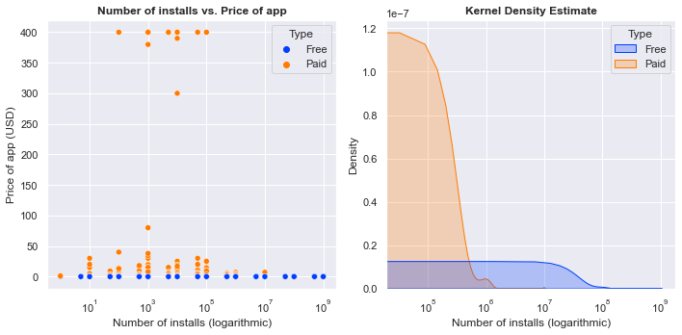
Data Exploration
Users install less paid apps then free apps

Slide 6
Data Exploration
Rating distribution between free and paid apps is similar
(Scatter plot shows different trend – importance of Boxplot)

Slide 7
Data Exploration
Paid apps has fewer reviews than free apps
Apps with more reviews are rated higher

Slide 8
Regression Model Comparison (No Hyper-parameter Optimization)
Rating ~ Sentiment + Reviews + Installs + Size + Price
Model | Test RMSE | R2 score
Linear Regression | 0.28 | 0.02
Random Forest | 0.27 | 0.12
XGBoost | 0.20 | 0.50
XGBoost shows the most potential for further optimization

Slide 9
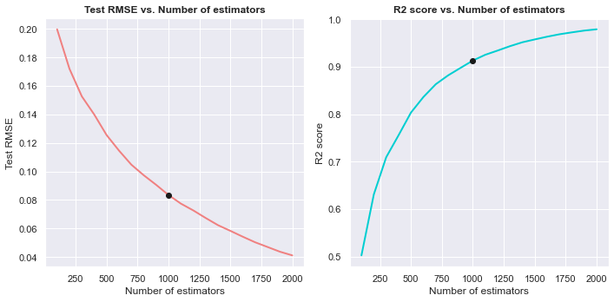
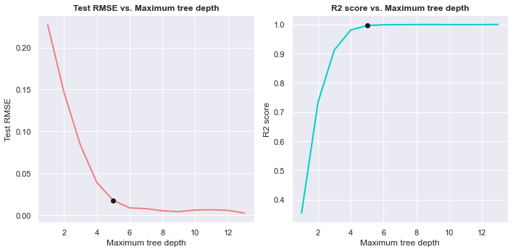
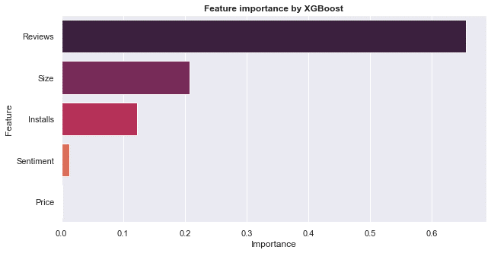
XGBoost Hyper-parameter Optimization
Number of estimators optimization
Maximum tree depth optimization
Feature importance
Model | Test RMSE | R2 score
Non-optimized XGBoost | 0.20 | 0.50
Optimized XGBoost | 0.02 | 1.00

Slide 10
Model performance on different data splits

Slide 11
Conclusions
The data set has relatively few features (features are correlated)
XGBoost performs extremely well after optimization of hyper-parameters
Feature importance might be influenced by feature correlation (Simpson’s Paradox)
Future tasks: Examination of deep learning algorithms

